Slide 1
DESTINI HUB
Beck-Technology.com

Slide 2
Why DESTINI HUB?
Speed up implementation and shorten time-to-value
Out-of-the-box content
No customer setup required
Customer spending less time during implementation
Efficient workflows and ongoing value
Less upkeep of standard content as the product evolves
Ability to provide innovative content

Slide 3
HUB Levels
Baseline HUB
Uncosted database with assemblies
Standard dashboard
Standard Power BI cost history dashboard
Four (4) standard reports
Standard customer success commitment
Access to Beck Tech training portal
Quarterly reviews with CRE team
HUB+
Includes Baseline HUB, plus:
HUB database with costs added through BNI
Additional customer success hours with hands-on training
Additional reports*
Additional dashboards*
* As additional functions are created
BNI Cost Database
Additional direct access to BNI data
Roughly 9500 line items
HUB will continually evolve with support from Customer Community

Slide 4
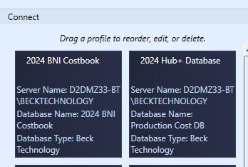
Updates & New Content
All cost databases will be updated annually
New pricing
New/improved assemblies
Distributed as a new DB into their hosted environment
Other content will be added/updated as generated

Slide 5
Assembly Demo

Slide 6
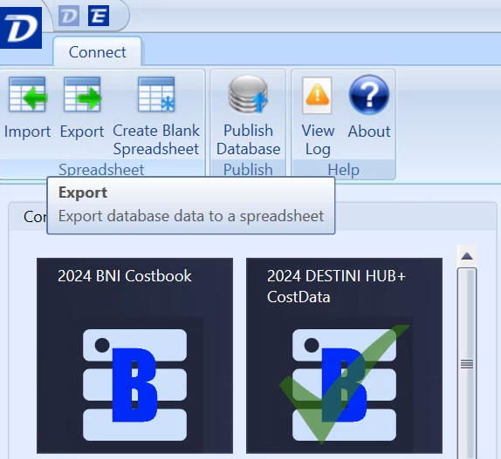
Make the DB Yours
Export a copy of the HUB and your database

Slide 7
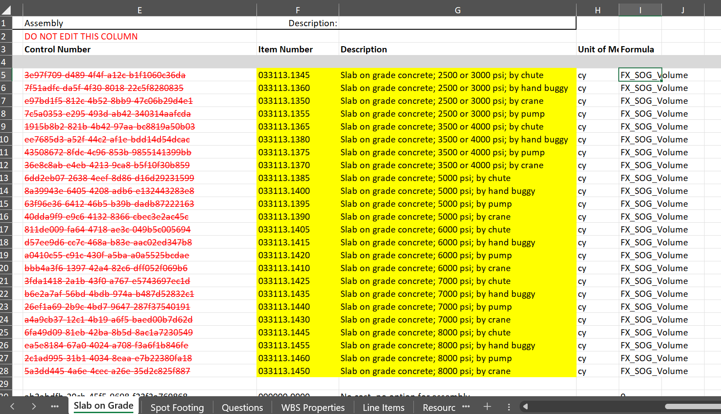
Replacing the Line Items

Slide 8
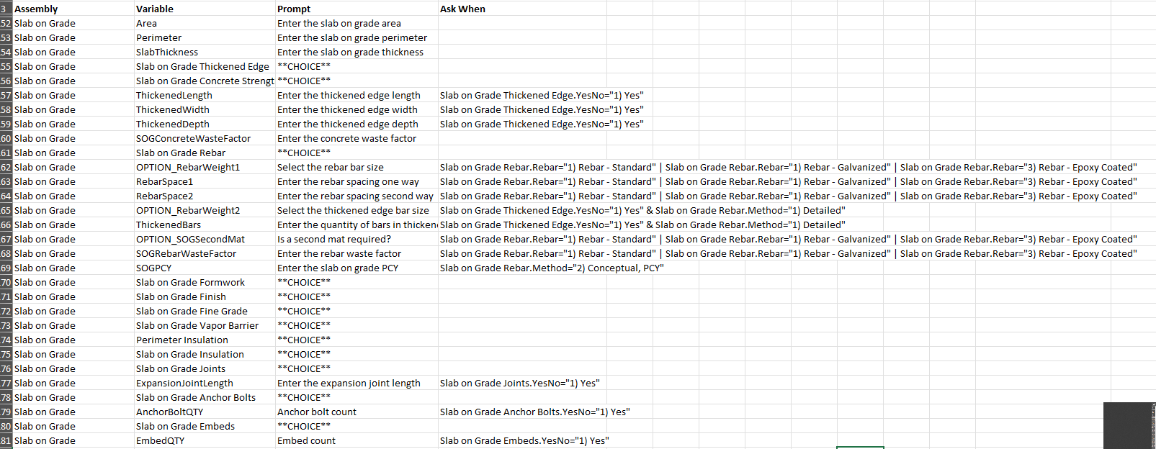
Copy the Questions

Slide 9
Copy the Formulas and Variables

Slide 10
Q&A
Beck-Technology.com

Slide 11
THANK YOU
Email: CustomerSuccess@beck-technology.com
Beck-Technology.com

