Slide 1
Retrospective:
A Look Back at DESTINI Estimator Innovations
Beck-Technology.com

Slide 2
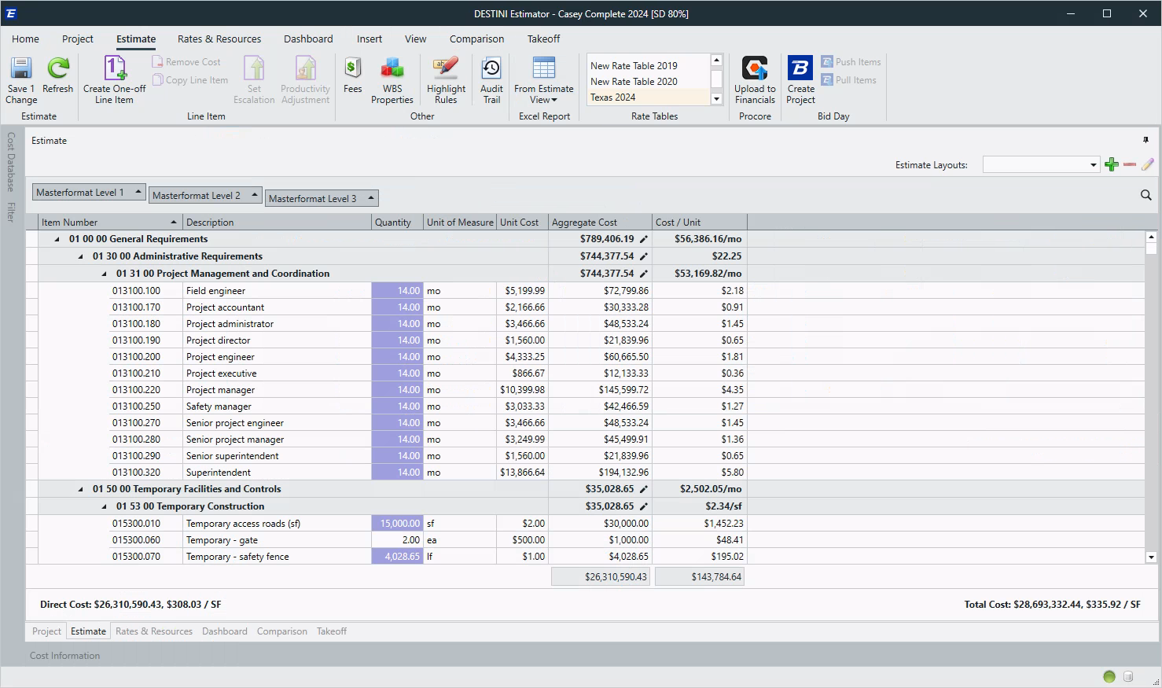
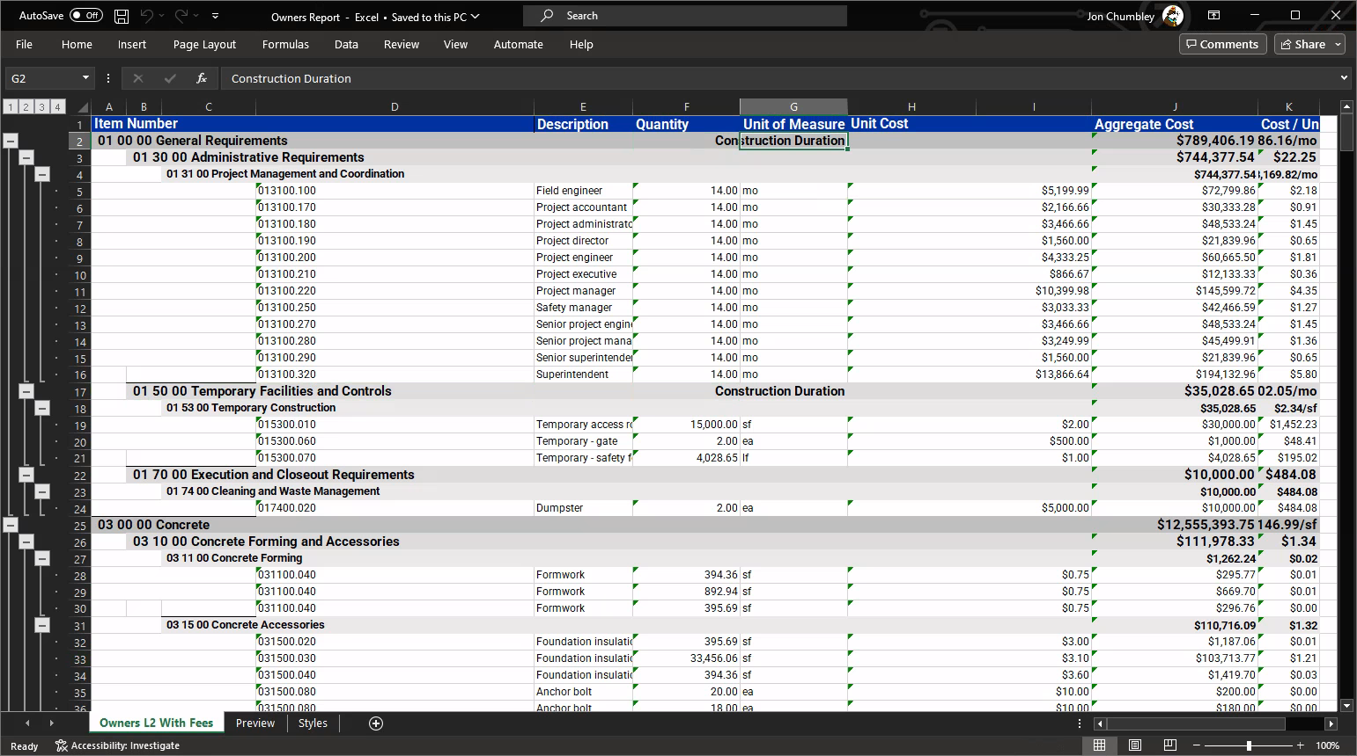
Estimate View Excel Report

Slide 3
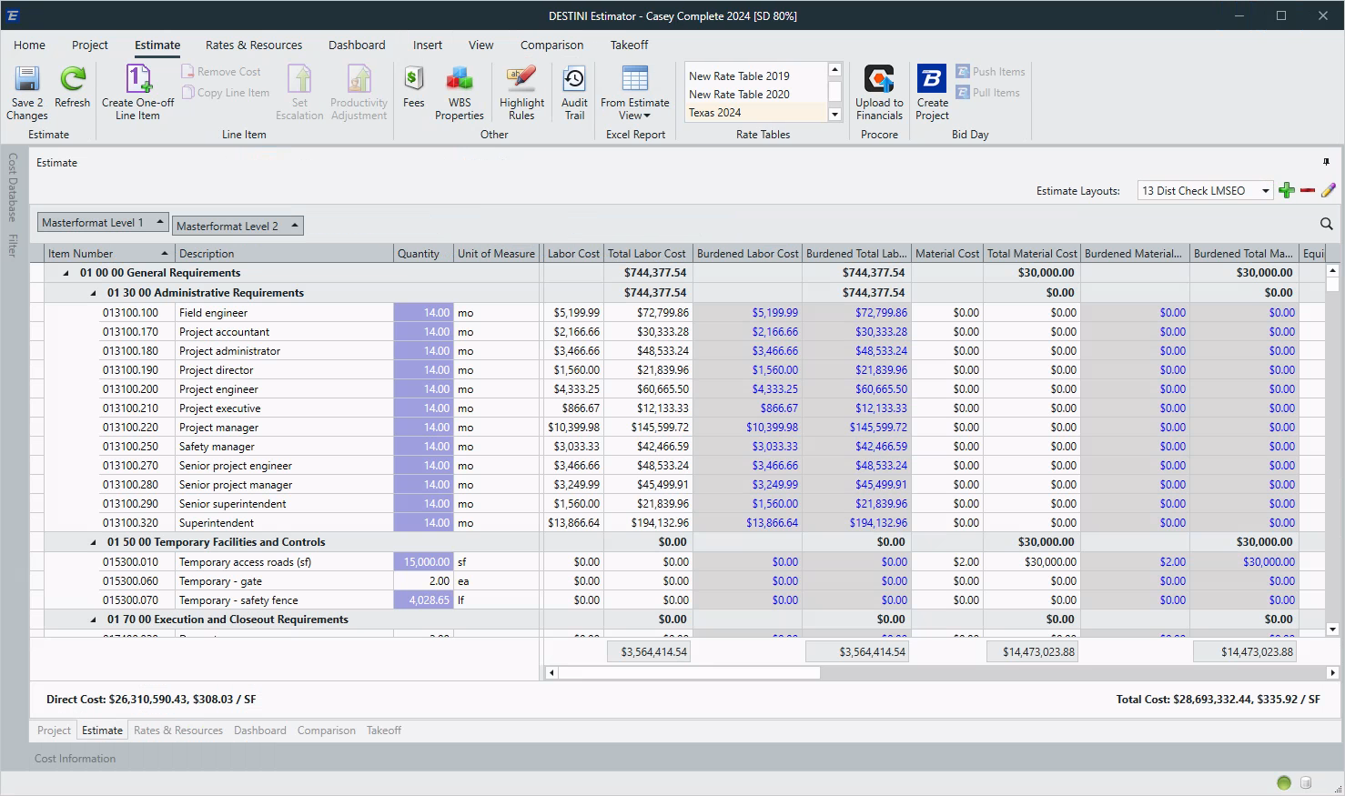
Burdened Cost Columns

Slide 4
2D Enhancements
Making Takeoff Quicker
Beck-Technology.com

Slide 5
2D Measure
Tool

Slide 6
2D Add Point
Split Polyline

Slide 7
2D Double Click
End Sketching

Slide 8
2D Convert
To Arc

Slide 9
Alternates
Released!

Slide 10
Performance & Stability
Pencils Down
Beck-Technology.com

Slide 11
Performance & Stability
Pencils Down
Open estimates up to 70% faster
Launching Estimator up to 60% faster
Data Entry up to 80% faster
Critical issues reported down 75%

Slide 12
Next-Generation Estimator
The Future
Beck-Technology.com

Slide 13
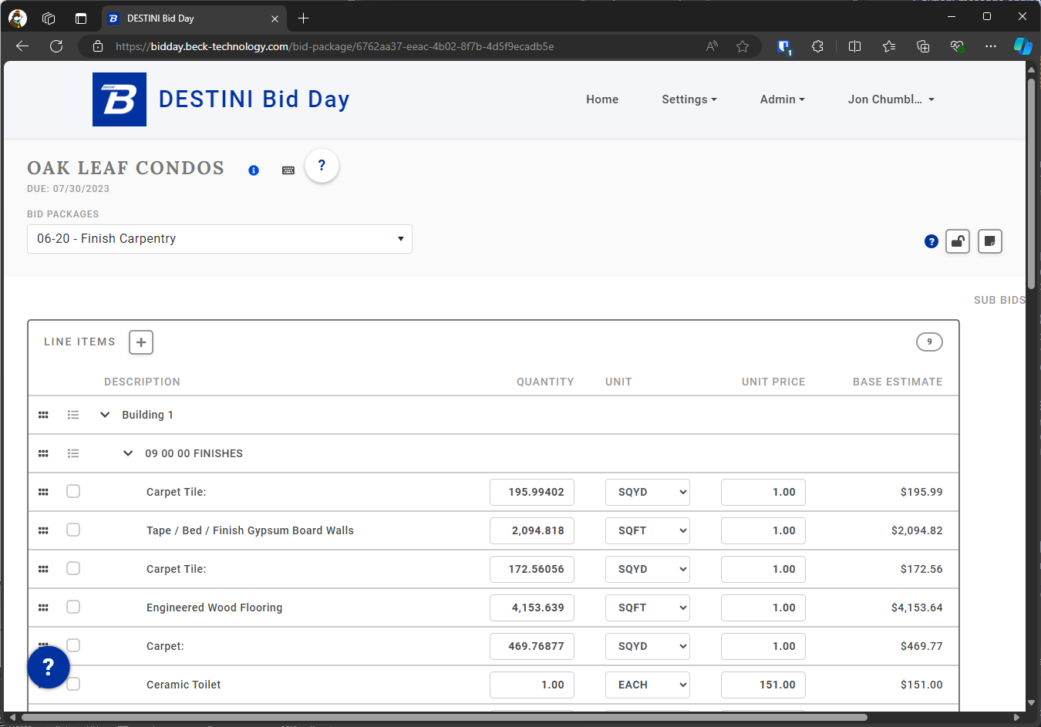
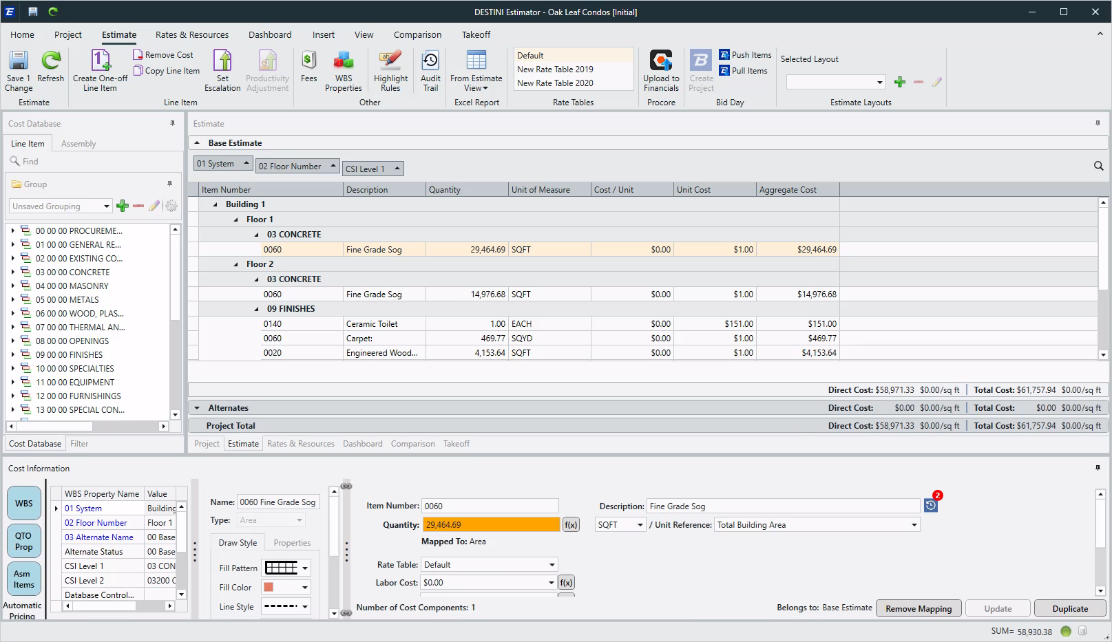
Browser vs
Thick Client

Slide 14
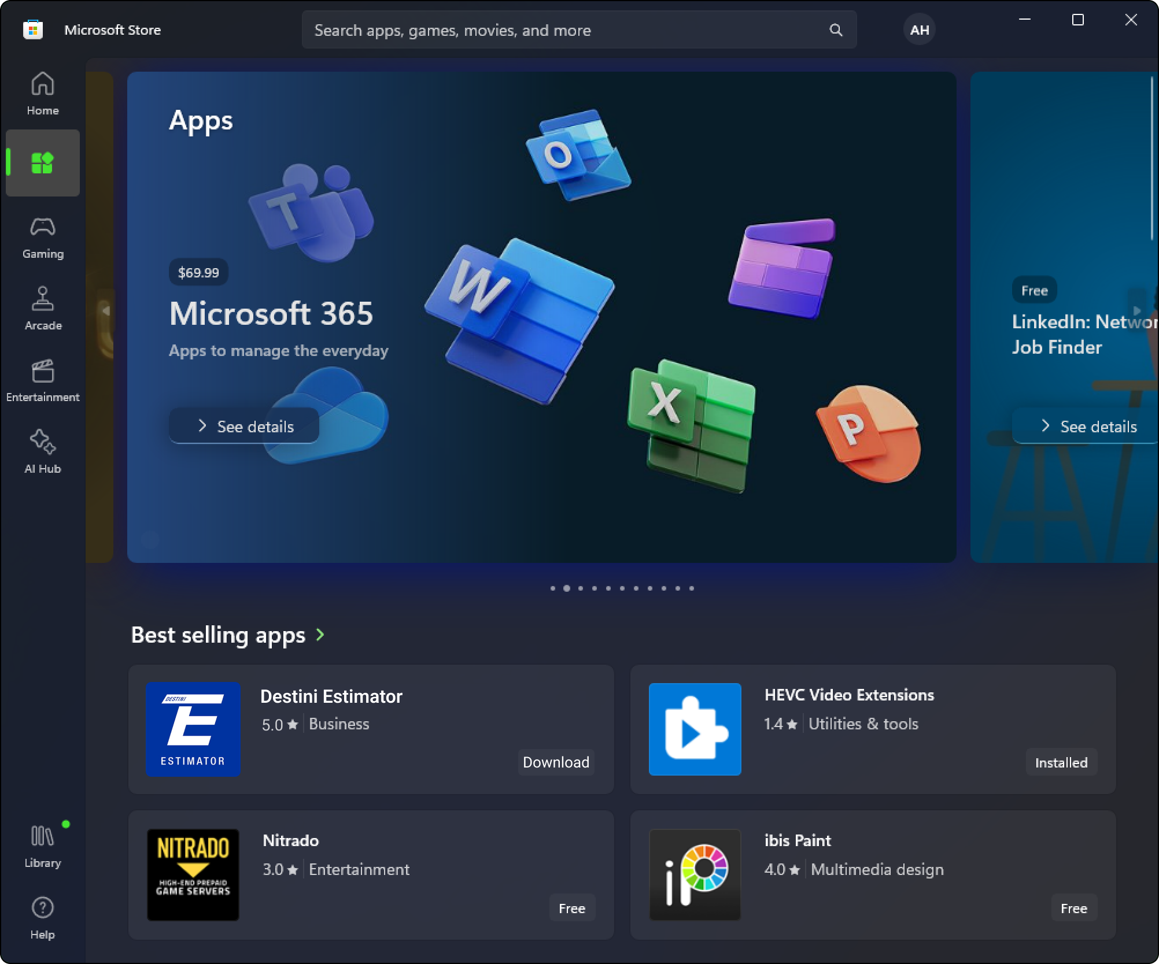
Deployment Options

Slide 15
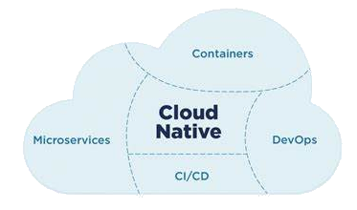
Next-Gen Estimator

Slide 16
Next-Gen
Estimator

Slide 17
No Save/Refresh
What does that mean?

